Slide 1

Machine learning
Youssef Mohamed Moustafa:22101287
Aladdin Ibrahim said:22101463
Rana HossamEldin Mohamed:22101478

Slide 2
Modules:
1)Logistic Regression
2)KNN
3) Bagging
Extra: 4) Ridge

Slide 3
Summary for the code:
We insert some library that we might use it.
we insert the data with and excel file.
We drop any coulombs that we don’t need in our data and clear the data.
we encode the data, and it must be all similar.
Start setting the data we have.
The last step before training and testing the module is splitting the data.

Slide 4
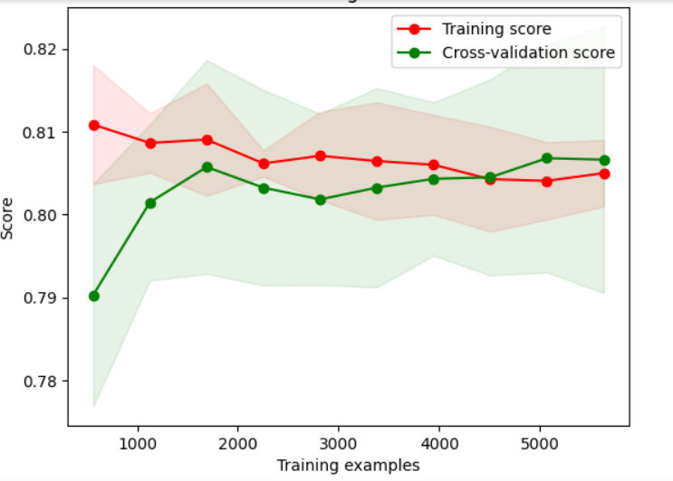
1)Logistic Regression:
Using the logistic regression because our data is a discrete data.
divides our data to 20% testing and 20% to the cross validation and 60% to our training.
It gives us accuracy about 80%.

Slide 5
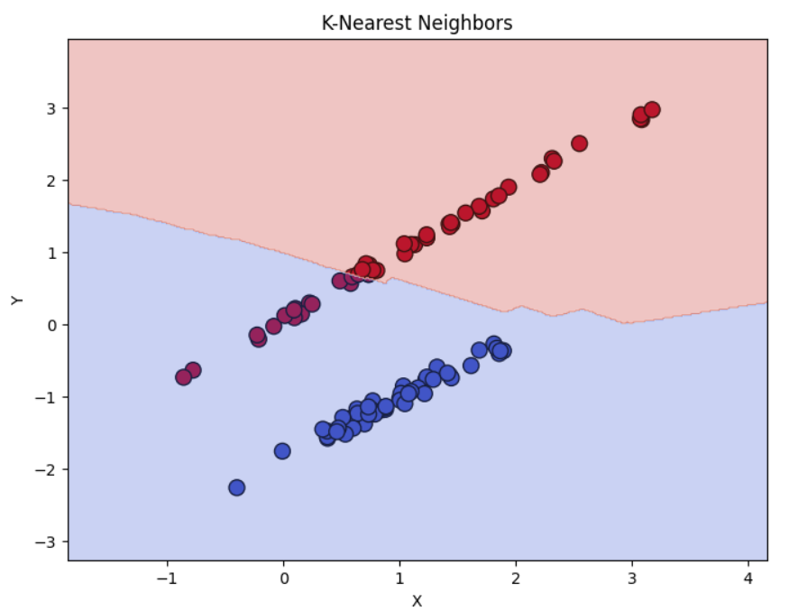
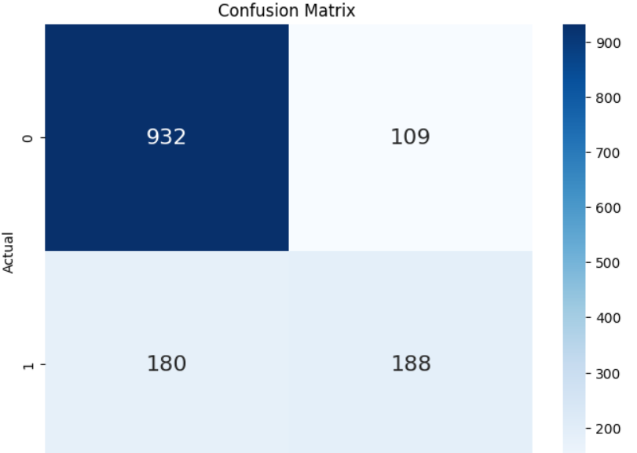
2)KNN:
Using the n=83 as this is the approximation of the root of the number of inputs which is 7000.
It gives us accuracy about 76%

Slide 6
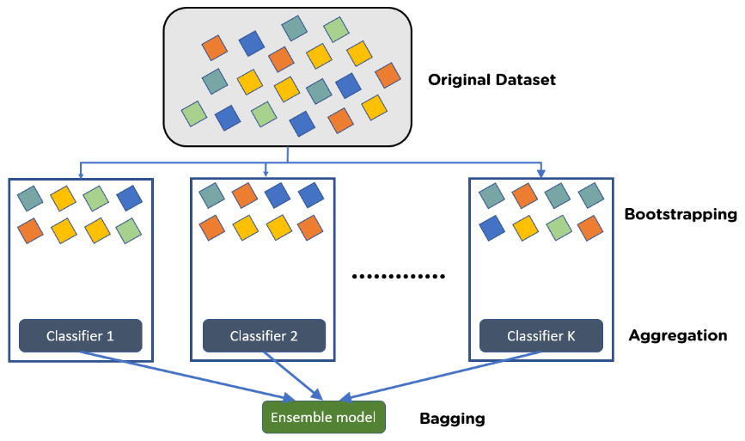
3) Bagging:
It uses to reduce the variance.
It acts like a strong learner as it compare a number of samples which is independent of each others.
It gives us accuracy about 78%.

Slide 7
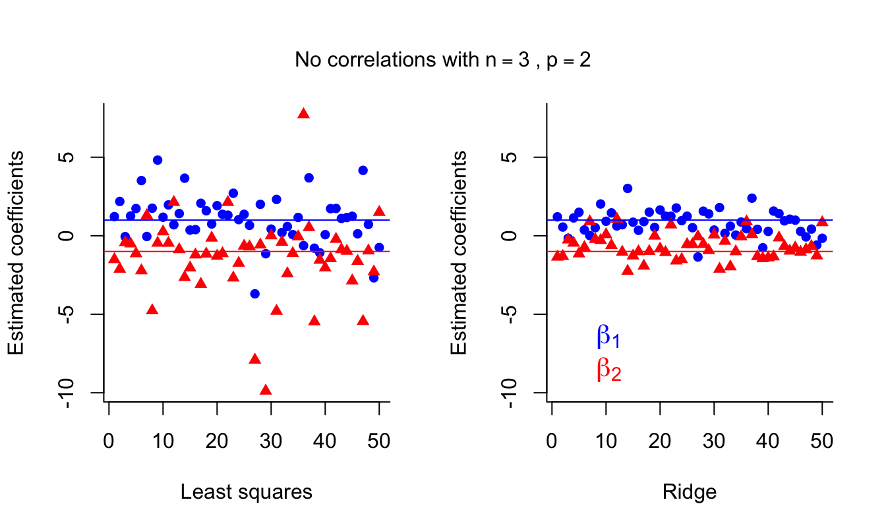
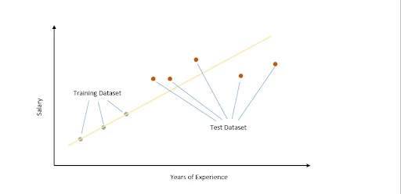
4) Ridge(bonus):
It gives the average between the overfitting and underfitting data to make us get a low variance and low bias.

Slide 8
Conclusion:
As we see the accuracy of the ridge was bad, we could fix it, but we have use it like this because it gives us a good accuracy in the other 3 modules and the best one in the accuracy and validation was the logistic regression.

